Slide 1
New life for old paper dictionaries
Macedonian Scientific and Professional Terminology

Slide 2
Introduction
Nikolche Mickoski
research associate - Lexicographic Centre at the Macedonian Academy of Sciences and Arts
I teach ICT-related terminology at the Department of Translation and Interpreting, Faculty of Philology Blazhe Koneski at Sts. Cyril and Methodius University in Skopje

Slide 3
Introduction
MA in translation and interpreting
PhD candidate – ICT-related terminology, termbase and terminology management

Slide 4
Macedonian Scientific and Professional Terminology
One of the first projects of the Macedonian Academy of Sciences and Arts – started in 1968
The aim of the project is to publish multilingual dictionaries for different terminology areas
Over 40 dictionaries published so far

Slide 5
Macedonian Scientific and Professional Terminology
90% of the dictionaries are available only in hard-copy
Over 60% are prepared on typewriter and not on computer
Multilingual with the following languages: Macedonian, Serbian and Croatian, Russian, English, French, German, Old Church Slavonic, and Latin

Slide 6
Current situation
All the dictionaries are scanned
OCR did not provide satisfactory results due to the number of different languages used
Similar languages with Cyrillic alphabet and similar orthography (Macedonian, Russian and Serbian)

Slide 7
Current situation
XML generated from recently published dictionaries (available in .doc, PDF, .sdltb) contains all the necessary metadata
Very big XML file (ex. 27 MB for 6,000 entries)

Slide 8
LexMC projects
Digitizing three dictionaries as pilot projects
1. one scanned paper dictionary prepared on typewriter
2. one scanned paper dictionary prepared on computer
3. one which is available in MS Word, PDF, .sdltb and XML

Slide 9
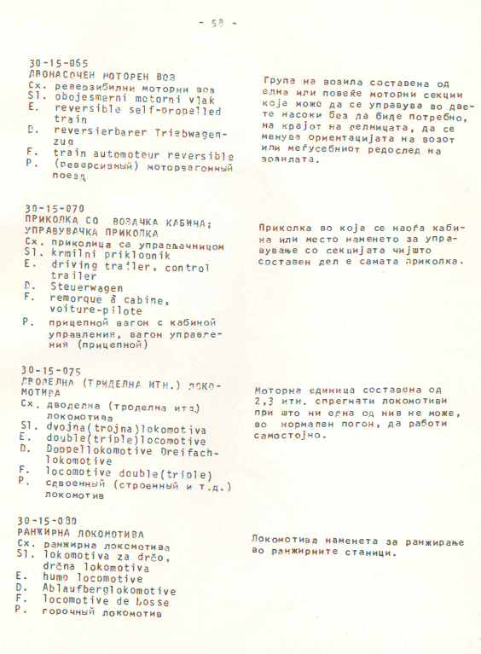
Scanned paper dictionary prepared on typewriter
Identify the best
OCR tool,
attempt for
good-quality OCR
attempt to
convert it into
XML format
Attempt to use
GROBID

Slide 10
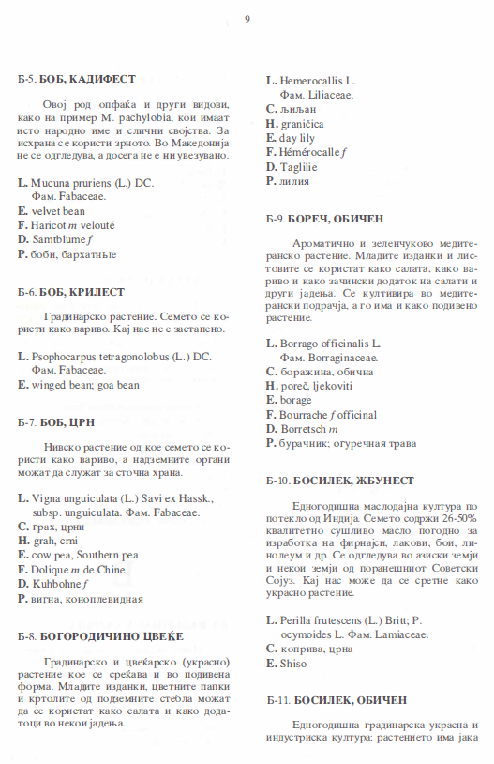
Scanned paper dictionary prepared on computer
Identify the best
OCR tool, OCR
and conversion
into XML format
Use GROBID

Slide 11
Available in MS Word, PDF, .sdltb and XML
conversion .doc, PDF and .sdltb into XML format
encoding the dictionary information of the written forms according to the TEI-Lex0
Prepare a template for future projects

Slide 12
Expectations of the LexMC
Learn how to use Oxygen, Xpath and GROBID
Learn how to present lexical content according to TEI-Lex0
Tips and tricks for managing digital lexica online (SVN, Gt, GitHub)
Successful completion of the pilot projects

Slide 13
Expectations of the LexMC
Meet researches and professionals who work on similar projects
Share experience and share ideas
Great Training of Trainers opportunity that will enable me to pass the acquired knowledge to my colleagues and to my students

Slide 14
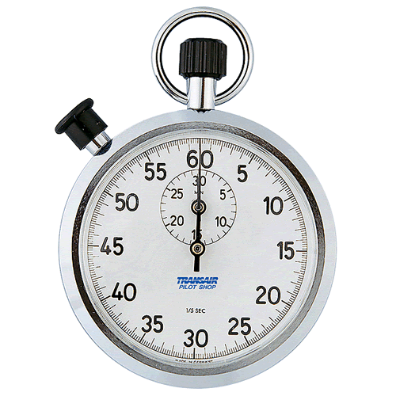
Time’s Up!
About the speaker:
  Name: Nikolche Mickoski
  Institution: Lexicographic Centre at
  Macedonian Academy of
  Sciences and Arts
  Social Media: @nmickoski1
  Quick bio: Lexicographer/terminologist, translator, interpreter

